Slide 1

Machine Learning Models to Optimize
Merchandising of H&M Store​
Presented By,
Sakshi Jain
Sakshi Tongia
Vaibhav Yalla
Lakshmi Naga Meghana Polisetty

Slide 2





Background & Motivation
Fast fashion retail industry is highly dynamic​ and competitive
To meet new trends, products are introduced frequently hence demand prediction is a challenge
​Sales depends on the geographical location of the store​
A right product assortment at the right price while meeting the anticipated demand is crucial to compete in this market
Forecasting correct demand and sales while understanding your target audience is the key to success in this industry
Notes:
the right products, at the right place, on the right time, in the right quantity at the right price. Merchandising is the non-verbal tactics retailers use for presenting and promoting their goods in-store

Slide 3
Problem Definition
Effective supply chain management is critical to retailers
Customers are very well-informed and relatively less brand loyal
Sales Prediction is difficult​ with the frequent addition of new styles
Retailers face challenges in providing the right product at the right time
Understanding the customer and retaining them is an added challenge
Build a Forecasting model to predict the product demand accurately using ML
Build a propensity machine learning model to understand the consumer needs by predicting their purchases through RFM analysis
Objective
Notes:
These models help predict the likelihood of a certain type of customer purchasing behavior, like whether a customer that is browsing your website is likely to buy something.

Slide 4
Literature and Technology Survey
XGBoost, Random Forest are the two algorithms that work really good for Demand forecasting using Supervised learning
Forecasting Models like ARIMA, Prophet outperform most of the algorithms
Customer segmentation worked best with K-Means Algorithm and there is no difference in accuracy for only RFM attributes,, and RFM with extra attributes
Random Forest and XGBoost ,SGD are widely used in customer purchase prediction

Slide 5
Project Framework: CRISP-DM Methodology
Product Demand Forecasting
And
Prediction of purchase Behavior
Business Understanding
Data Understanding
Data Preparation
Modelling
Evaluation
Deployment
Understanding problems H&M faces as a business
Exploring customer, products and transaction data
Organizing and finding patterns and relations between different entities.
Selecting the modelling technique to be deployed
Generating and analyzing the results obtained by each model.
Choosing the best fit model.
Searching for optimum solutions that benefits retail industry.
Analyzing quality of data collected.
Extracting the required data columns for the retail problem to be solved.
Preparing the data to run the model and see results
Reviewing the modelling process.
Defining the problem to be solved
Analyzing distribution and correlations between descriptive and target features.
Assessing different model implementations.

Slide 6
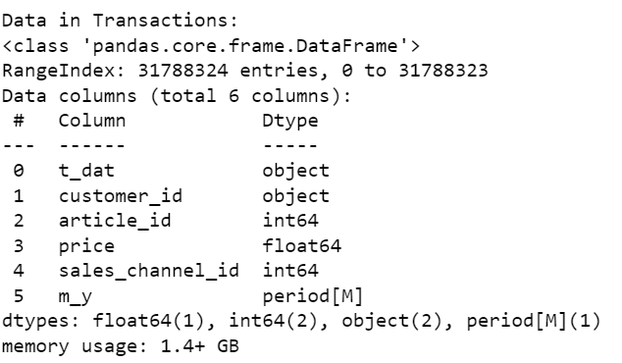
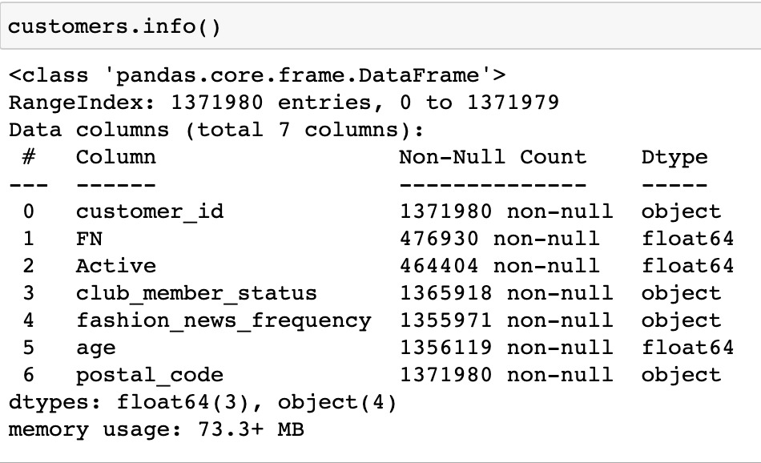
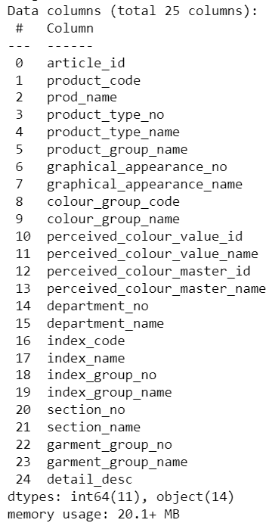
Dataset
Transactions
Customer
Purchase history of 13,71,980 customers across the time span of 2 years provided by H&M
H&M Dataset taken from Kaggle competition
3 Tables
Articles : 0.1M rows, 25 columns
Transactions : 31M rows, 6 columns
Customer : 1.3M rows, 7 columns
Articles

Slide 7
Product Demand Forecasting
Raw Data
Articles
Transactions
Data Pre-Processing
Exploratory Data Analysis
Feature Engineering
Preliminary exploration of whole data
Selection and creation of dataset for forecasting problem
Check Seasonality
Autocorrelation
Creation of lags
Normalize features
Choose lags based on PACF plots
Evaluation with different feature set
Removed identical columns
Performed Chi-Square test to check correlation of categorical features
Merged data to create dataset for forecasting problem
Plot
Ad-Fuller test
ACF
PACF
Remove Skewness of target Variable
Date-Sales
Date-Sales
+ Descriptive features
Data Preparation
Modelling and Evaluation
Training
Validation
Test
Baseline Model
Hyperparameter Tuning
Evaluate model Performance
Selecting the Best Performing Model
12/31/2019 07/01/2020 09/09/2020

Slide 8
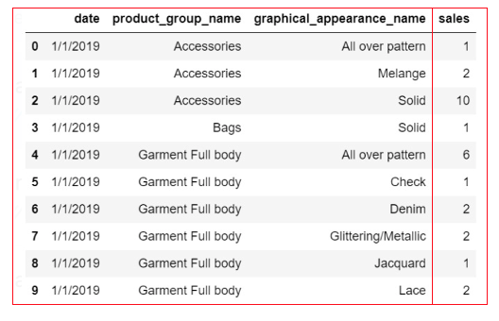
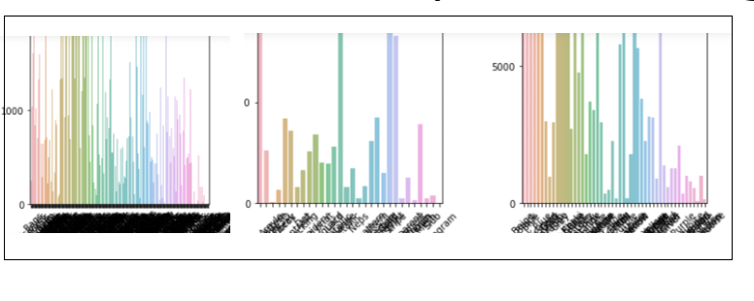
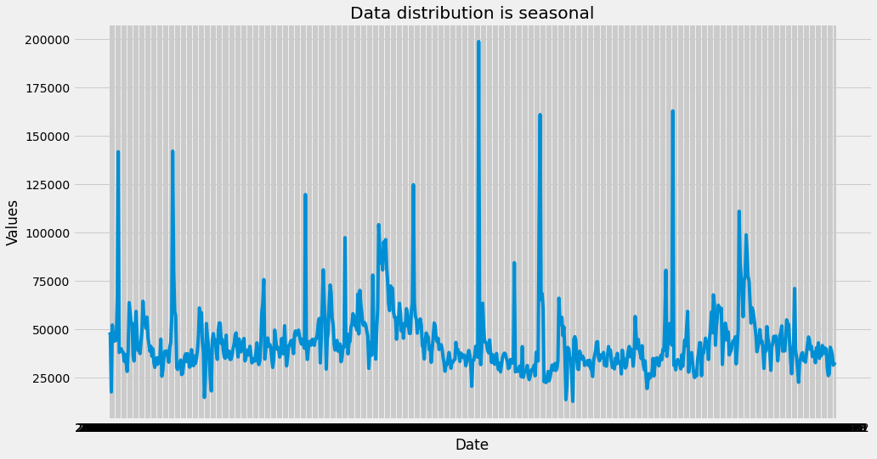
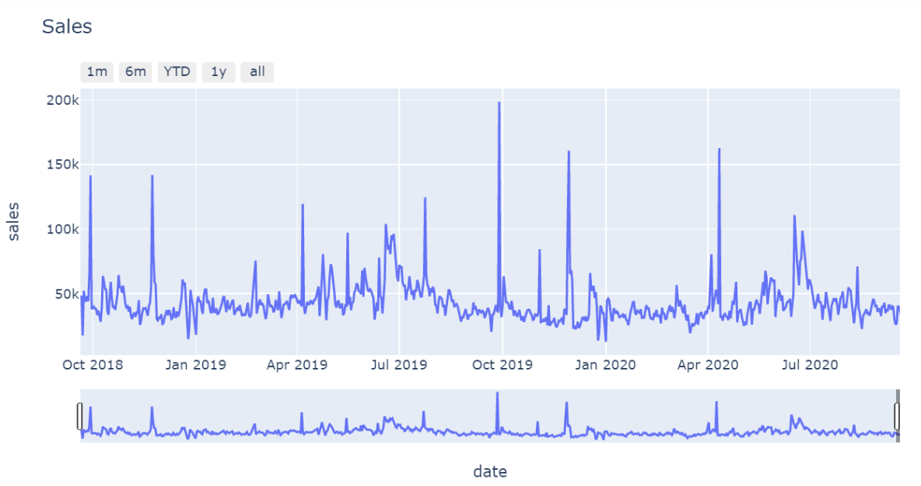
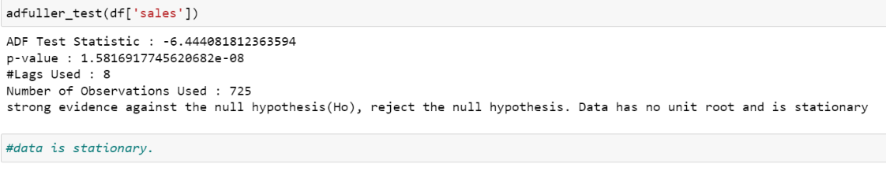
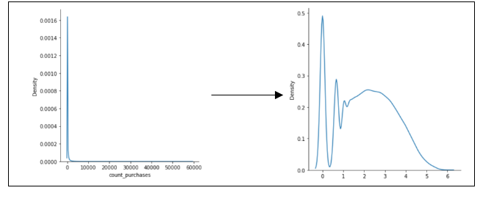
Product Demand Forecasting ( Checking Seasonality)
ABT 1
Checking the uniformity with respect to target Feature
Checking the seasonality-Stationary Data
Ad Fuller Test for stationary Data
We have a Stationary Data
Normalizing the Target Variable
Notes:
Ad Fuler test to check the seasonality quantitatively (Hypothesis testing)

Slide 9
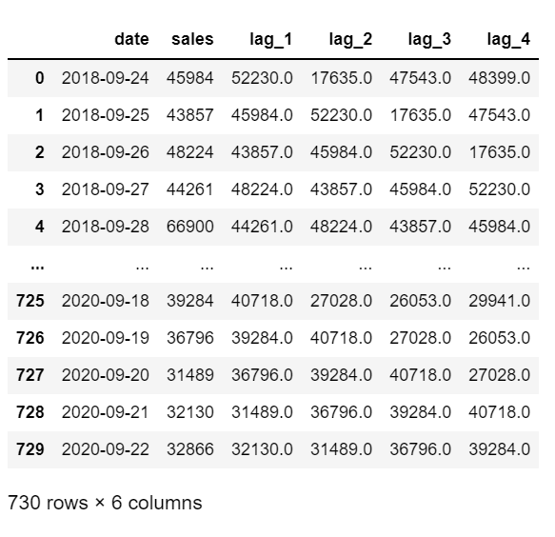
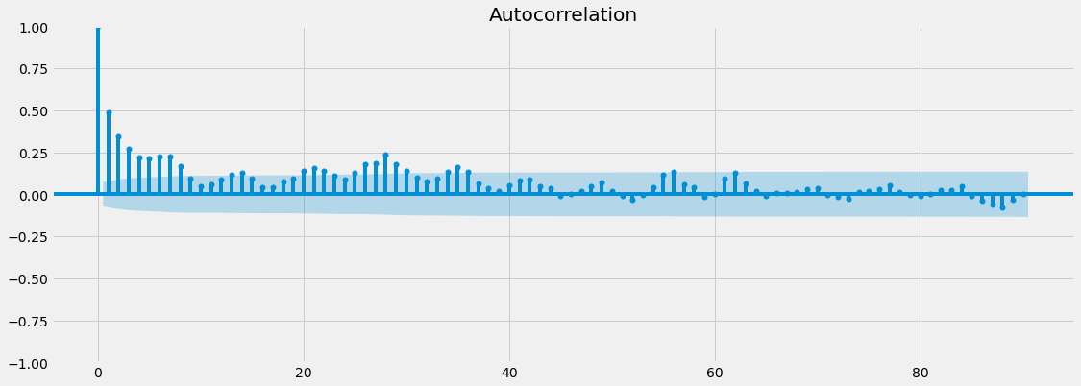
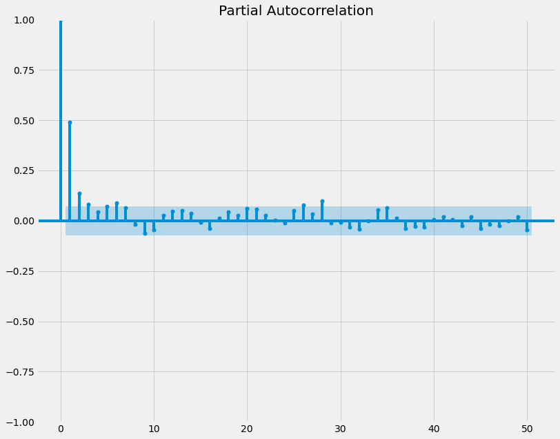
Data Pre-processing for Demand forecasting(Autocorrelation)
Date & Sales
Notes:
We started our prediction by using just 2 features - date as descriptive and sales as target We did autocorrelation plotting to find the pearson co-eff.
how it works? you count the no. of spikes above this blue lines and them as no. of lags.. or days in our case.
we got 4 lags

Slide 10
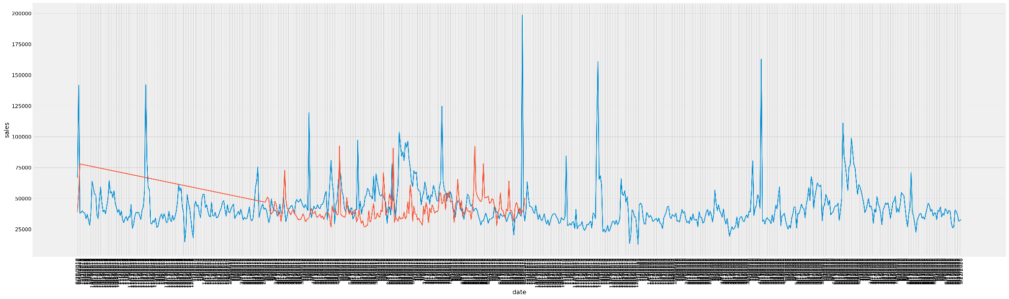
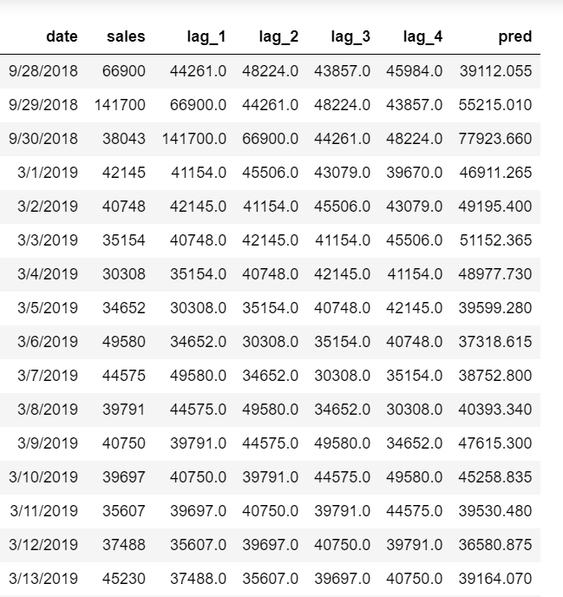
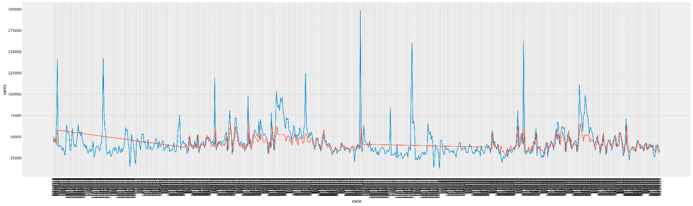
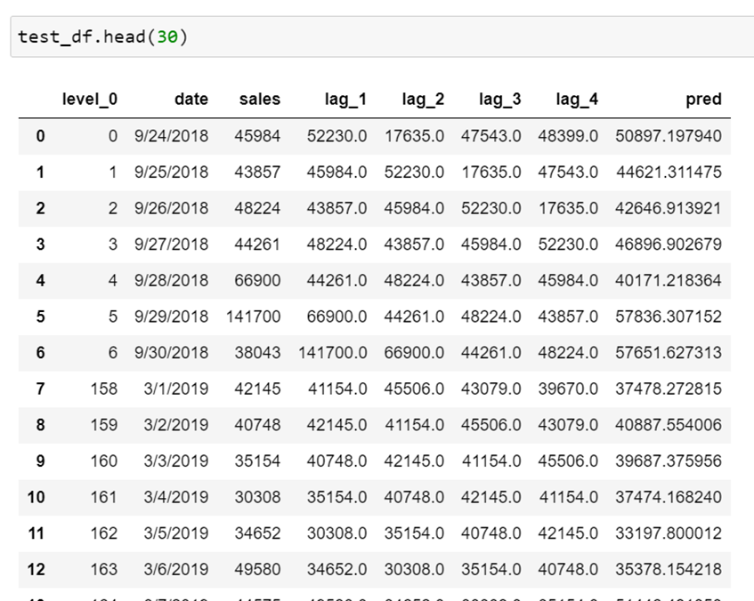
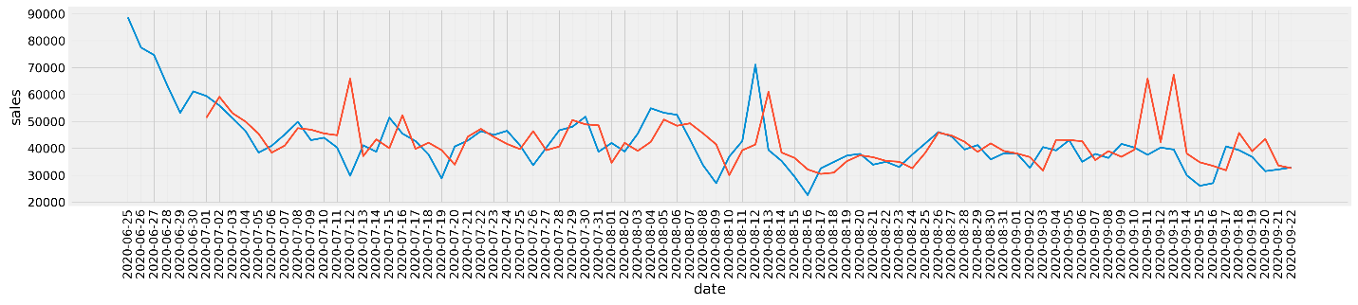
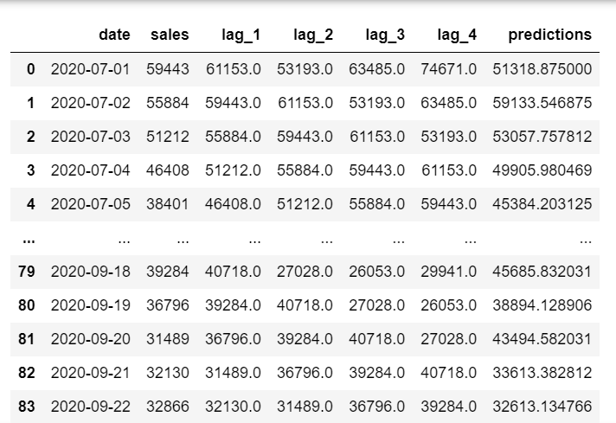
ML Algorithms for Product Demand Forecasting
RANDOM FOREST-
BASE
RANDOM FOREST GRIDCV
XGBOOST
Notes:
Now that are lags were ready, we passed in these lags as our descriptive feature and sale as target variable to the ML models
we started with random forest having really poor prediction. You can see the red line is not at all merging with the blue line.
Grid CV helped a bit. you can see some overlapping
XGBoost worked best.

Slide 11
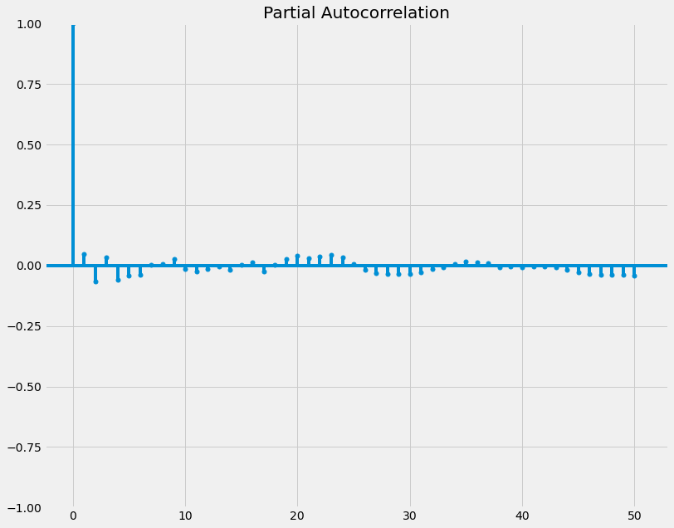
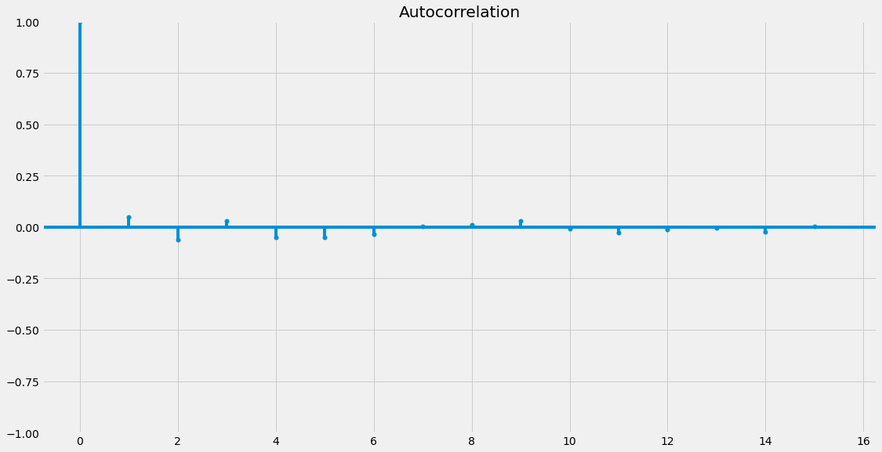
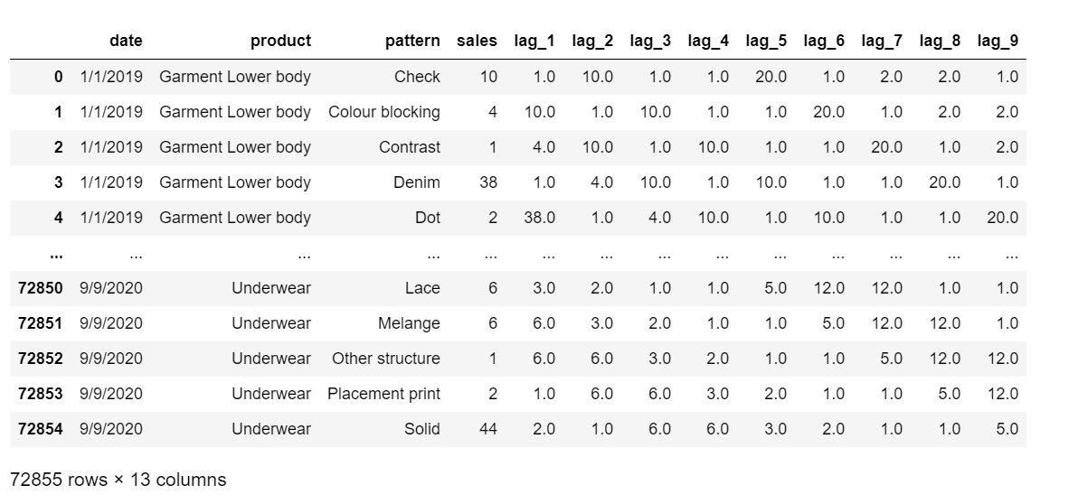
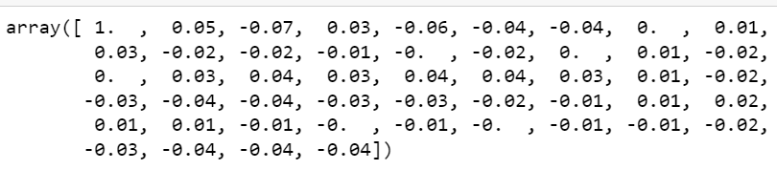
Data Pre-processing for Demand forecasting(Autocorrelation)
Date ,Sales,
Descriptive features
Notes:
The models didn’t perform that well. So we decided to add some more features to our dataset.

Slide 12
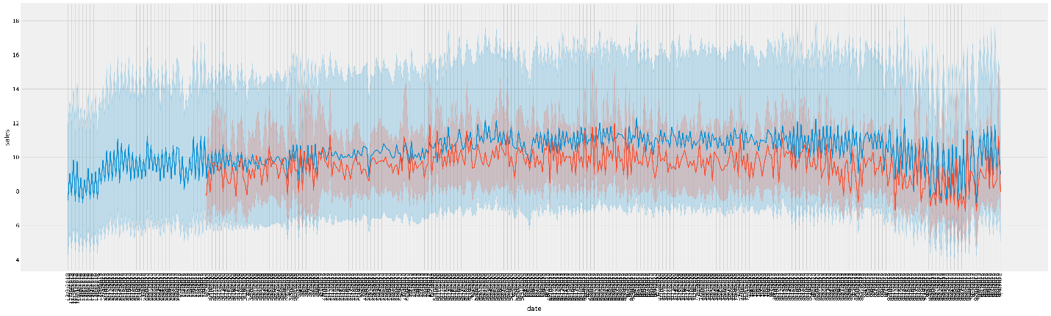
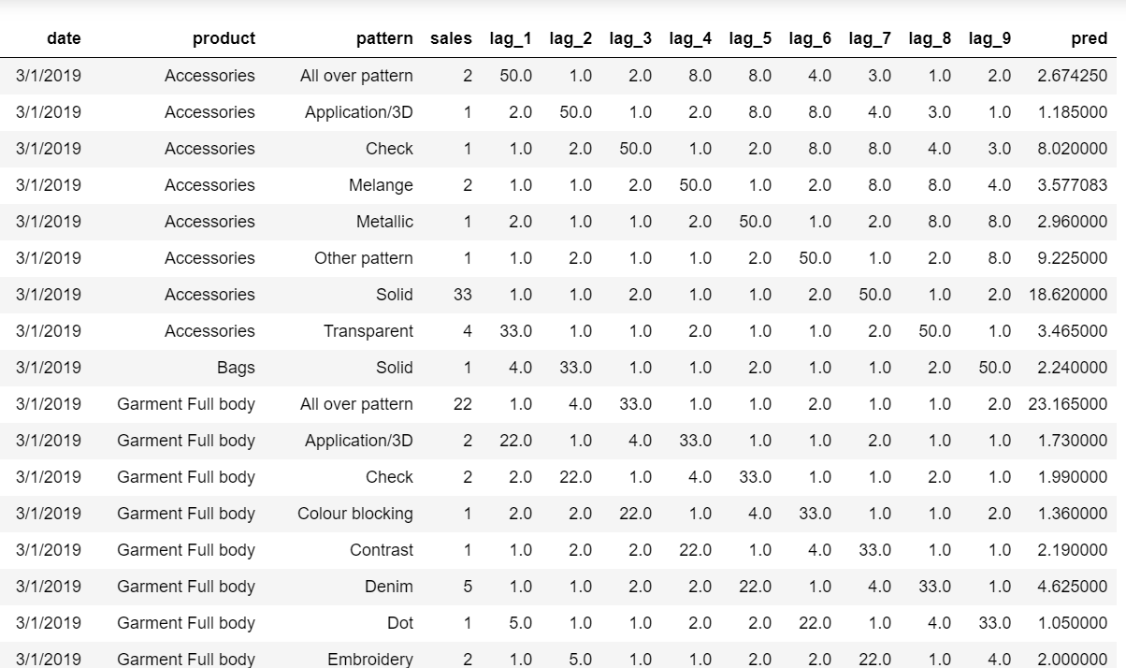
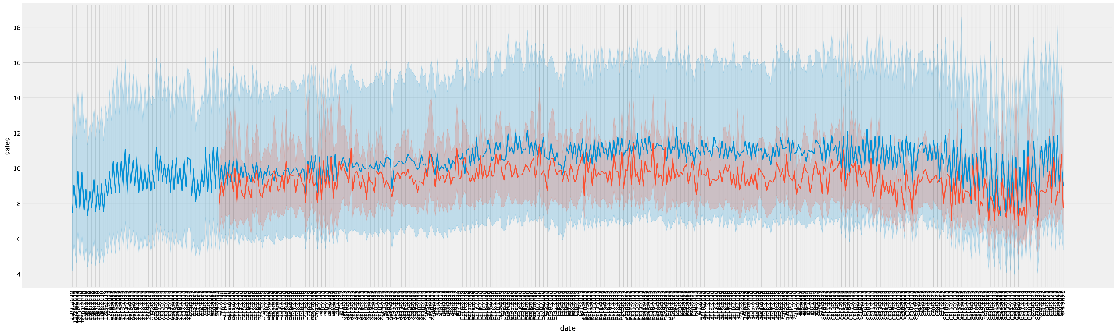
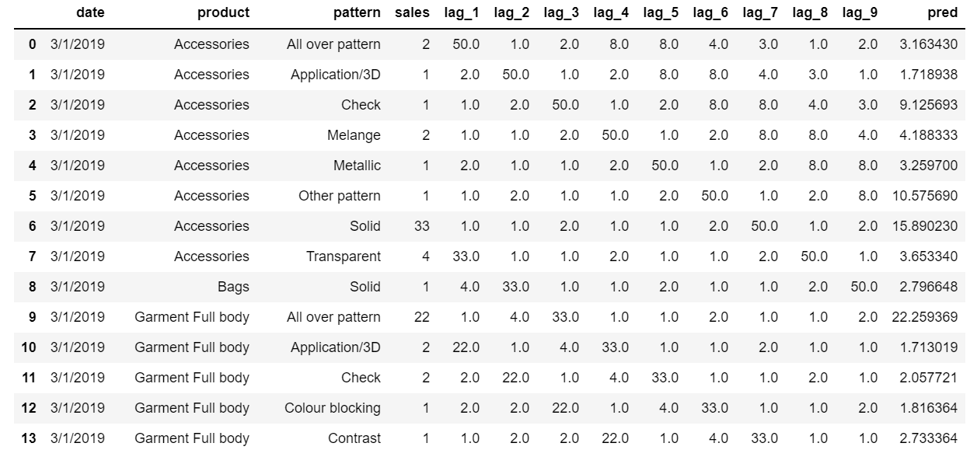
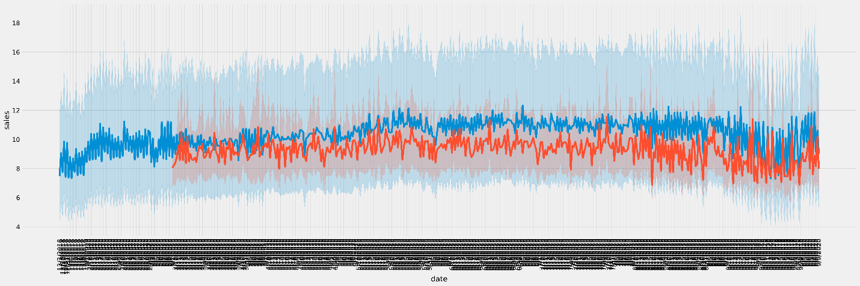
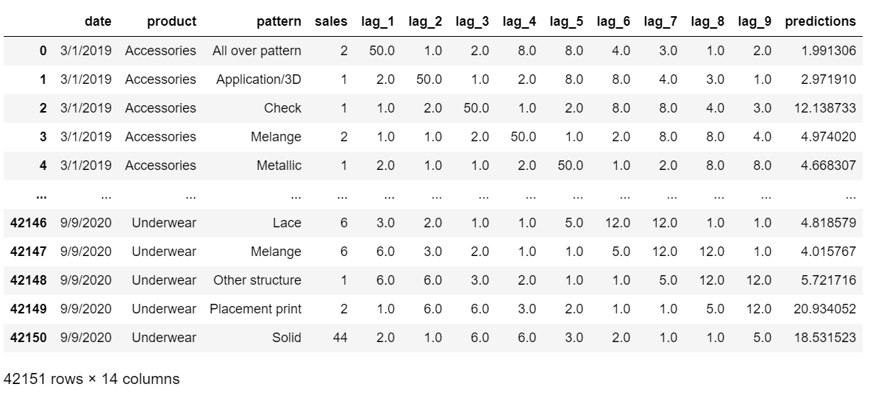
ML Algorithms for Product Demand Forecasting
RANDOM
FOREST-
BASE
RANDOM FOREST GRIDCV
XGBOOST

Slide 13
Results
Date-Sales
Algorithm | Mean Sqr Error | Mean absolute Error | Root Mean Sqr Error | R2
Random Forest Base | 17431.08 | 9060.51 | 9.766 | 0.48
Random Forest Grid CV | 11988.53 | 8192.22 | 8.109 | 0.61
XGBoost | 10629.112 | 8024.37 | 7.621 | 0.623
Date-Sales-Descriptive Features
ALGORITHM | Mean Sqr Error | Mean Absolute Error | Root Mean Sqr Error | R2
Random Forest Base | 9.209 | 8.6 | 2.95 | 0.548
Random Forest Grid CV | 8.44 | 7.55 | 1.76 | 0.635
XGBoost | 8.33 | 6.73 | 1.31 | 0.67

Slide 14
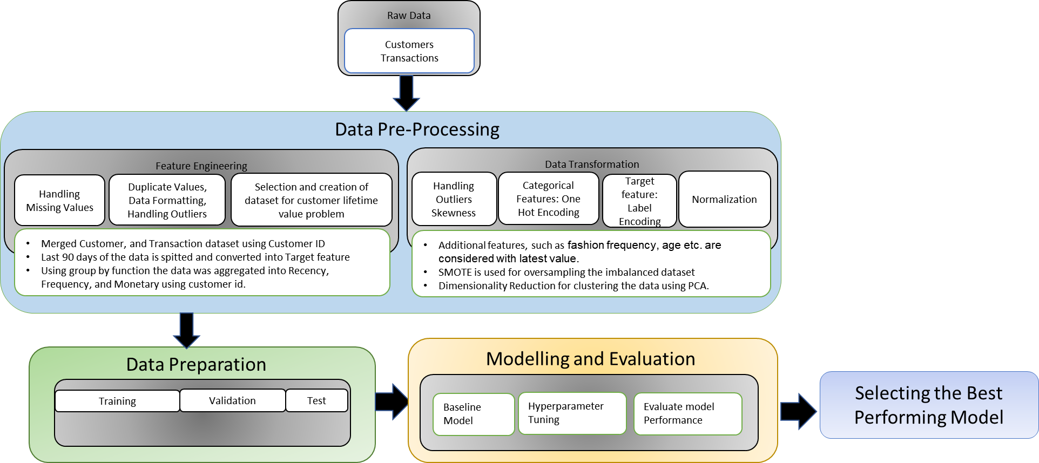
Customer Lifetime Value Analysis based on RFM
Notes:
Next we are going to see the model prediction for CLV based on RFM
Here, our aim was to predict whether a customer will make a purchase in the next 90 days, the total purchase amount made by the customer in the next 90 days.
We have tried to use the propensity modeling approach to forecast the behaviour of the customer.
We have used the last 90 days of the data for target features
We have observed that the data has missing values,duplicate values, outliers and skewed data. We have performed EDA to understand the behviour of the data and used transformation methods to handle these issues.
Later, once we have obtained the appropriate data for forecasting, we have split the 60% data for testing 20% of the data for training and the remaining 20% of the validation.
We have initially performed modelling using base models like XG, RF , RL

Slide 15
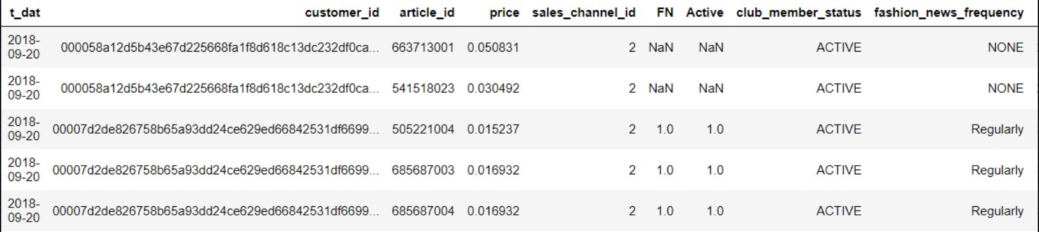
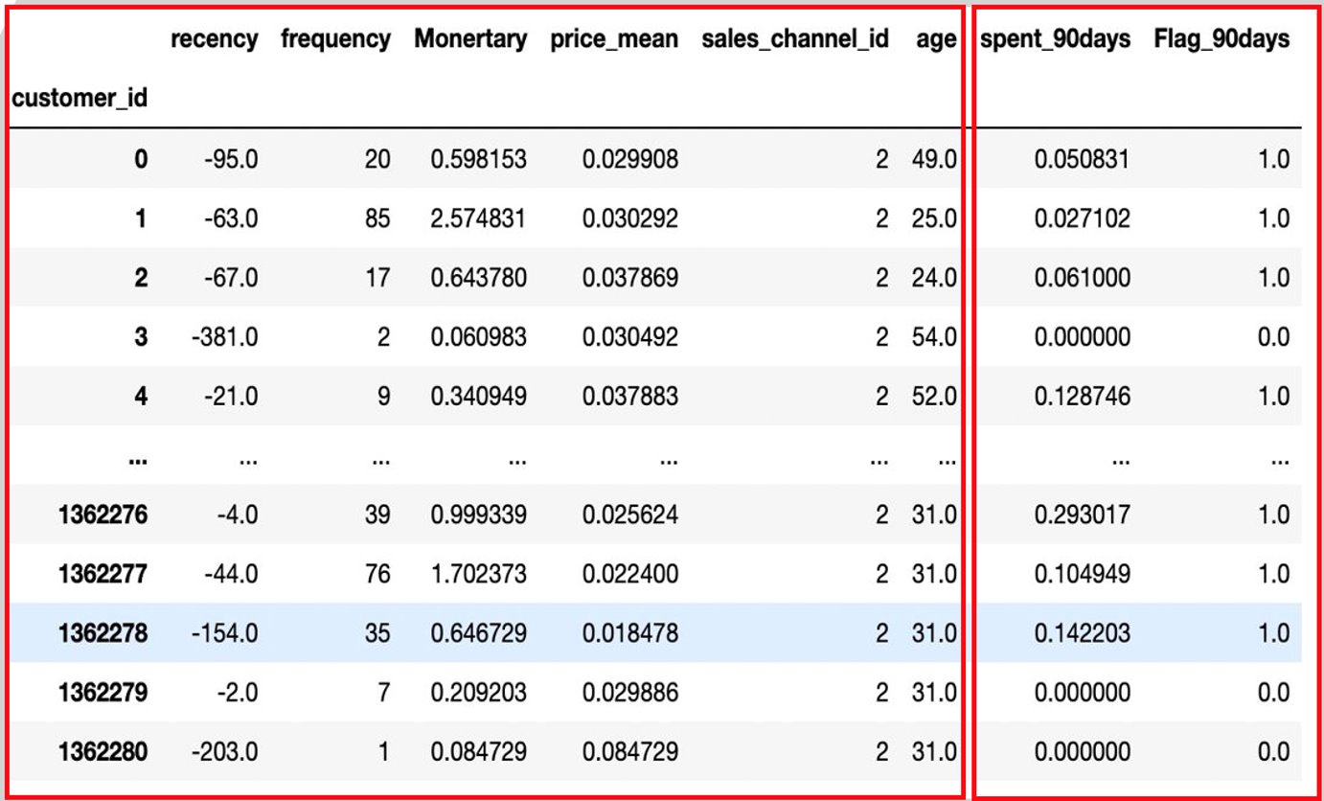
Customer Lifetime Value based on RFM Analysis (recency, frequency and Monetary)
TOTAL COUNT OF TRAN BY EACH CUSTOMER
RECENCY = MAX DATE – LAST PURCHASE DATE OF THE CUSTOMER​
MONETARY = SUM (TRANSACTIONS) OF EACH CUSTOMERS​
Classification to understand if the customer would make a purchase in the next 90 days.
1.XGBoost Classifier
2.Random Forest Classifier
3.Stochastic Gradient Descent
Logistic Regression
Clustering of customers based on RFM -
K-Nearest Neighbour
Introduced new features RFM and creation of dataset for solving the segmentation problem
Notes:
recency - based on the lastb purchase made by the customer
frequency - how frequent the customer made a purchase in the given dataframe
monetary - cumulative sum of the amounts of all the transactions made by the c customer in the given dataframe
to calculate these features we have grouped by the customer id.
spent_90 - again group by on customers, we have calculated the cumulative sum of all the transactions made by the customer
Flag_90 - if the spent_90 days on the given customer was 0 - the flag was updated to 0 which is indicating no purchase and if there is a positive sum on the customer spent then the flag is updated to 1 indicating there is a purchase
this is how we have trained the data (60%)

Slide 16
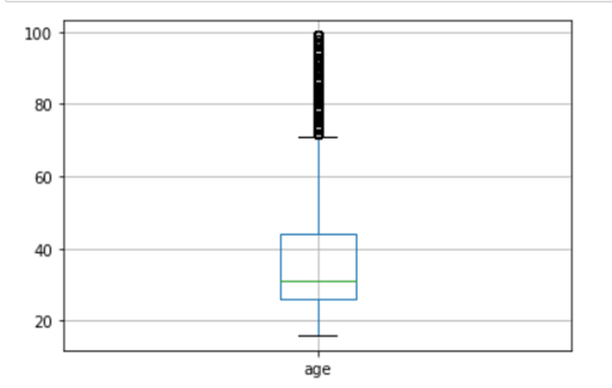
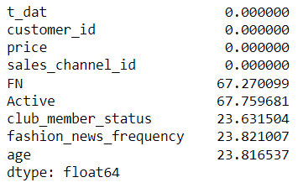
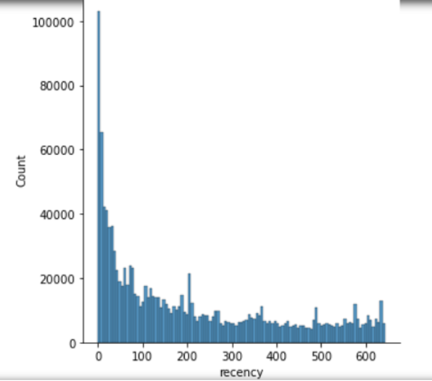
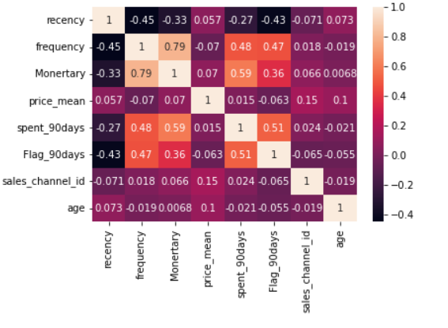
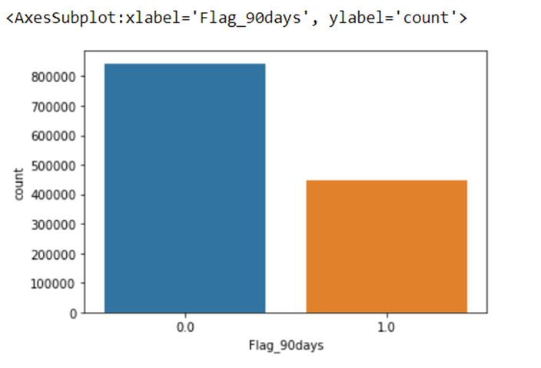
Derived Features
Missing values in the dataset
Outliers
Skewness in the dataset
Correlation between the features.
Imbalanced data.

Slide 17
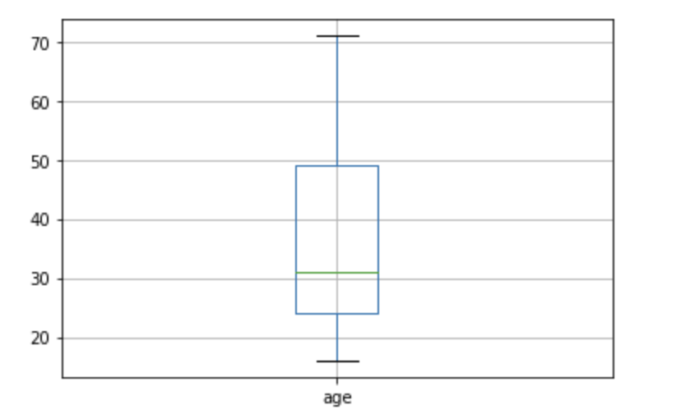
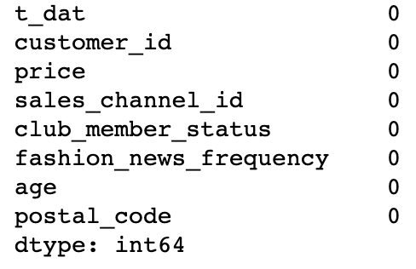
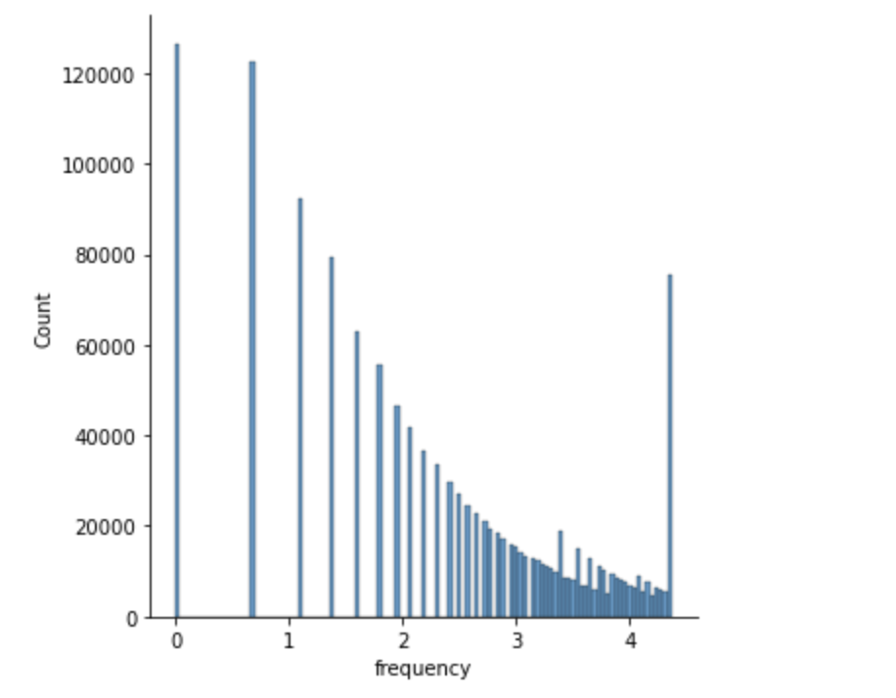
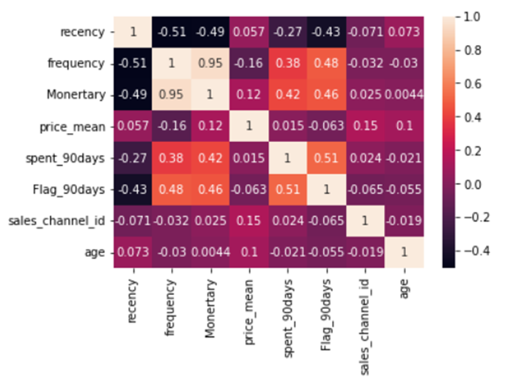
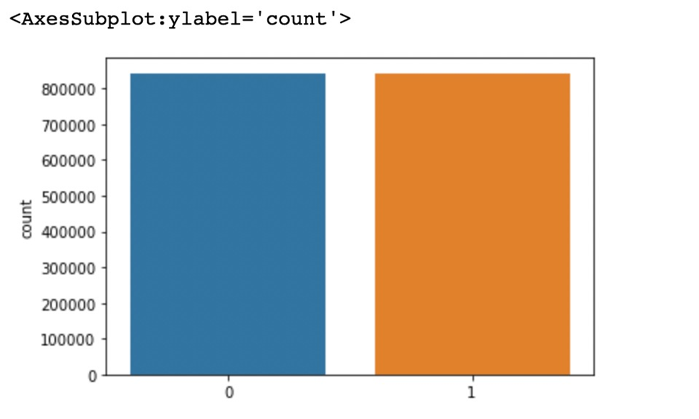
Target Features : spent_90days, Flag_90days, introduced new features based on the CLV analysis RFM
Handled Missing Values
To handle the age outliers,imputed the data with the MAX(Age) in the data
Based on the correlation observed, performed Log Transformation to handle the skewness.
To handle the imbalance data, we have used SMOTE(oversampling)

Slide 18
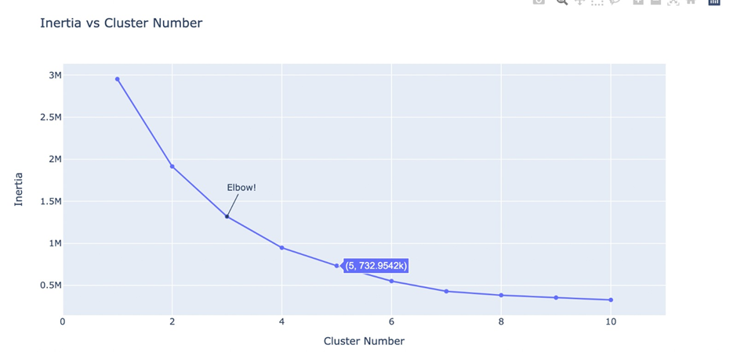
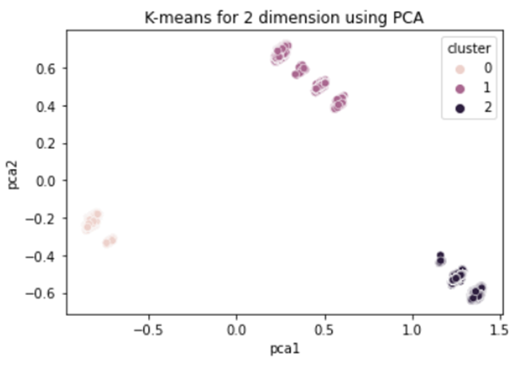
Customer Segmentation using Clustering
Dividing customers into three different groups, each with different categories.
These were clustered into groups based on the RFM attributes, and other features of the customers such as age.
Using the K-means algorithm the customers were divided. PCA was used so the dimensions are reduced for visualization
Elbow curve is used for the number of K values of which the data is divided into.

Slide 19
Results for CLV Modeling
Algorithm | Accuracy | Precession | Recall | F1-Score
Logistic Regression | 0.75 | 0.76 | 0.76 | 0.76
Stochastic Gradient Descent | 0.74 | 0.70 | 0.84 | 0.76
Random Forest (without oversampling) | 0.75 | 0.73 | 0.73 | 0.73
Random Forest (with oversampling | 0.81 | 0.81 | 0.81 | 0.81
Random Forest (with Hyperparameters) | 0.82 | 0.82 | 0.81 | 0.82
XGBoost (without oversampling) | 0.76 | 0.75 | 0.75 | 0.76
XGBoost | 0.82 | 0.82 | 0.82 | 0.82
XGBoost (with Hyperparameters) | 0.83 | 0.85 | 0.82 | 0.83

Slide 20
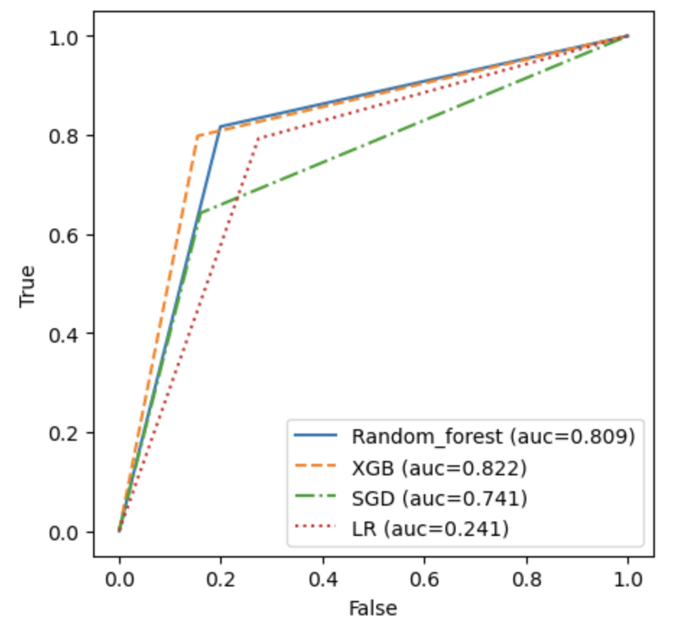
Model Evaluation CLV Modeling
Random Forest, XGBosst without resampling and KNN without resampling does not perform well in terms of Accuracy, Precision, Recall, F1 Score and Kappa Score
Clustering is used for customer segmentation using K-means
SMOTE Upsampling drastically increases the computational time, and better accuracy as those without any resampling

Slide 21
Limitations and Conclusion
1. Using XGBoost and Random Forest did not work well with forecasting. Using Arima or Facebook's prophet model would be a better choice.
2. The data used was only of 2 years and not giving much variance.
3. It is a fast fashion brands having plethora of products. Model will work well with a balance of dataset.

Slide 22
Thank You !!!

